Slide 1
Application Development Orienting – Week 2
If-Statement and Styling

Slide 2

Previously in ADO
Topics of last week
Introduction to ADO
Programming languages
Windows Forms Applications and basic Controls
Variables and Operators

Slide 3

Content
Topics of this week
Conditional statements: if-statement
In-/equality and logical operators
Styling
Formatting strings
Controls: PictureBox & CheckBox
Variable scope
Learning objectives
Implement alternative scenarios by using an if-statement
Build conditional statements using the corresponding operators
Produce readable and standardized code

Slide 4

Intro: if-statement
To make a decision based on some given data
E.g. an app where you can order beer only if older than 18
If your age is bigger than 18, then you can order beer
Else, show message that it is not possible

Slide 5

Syntax
Two building blocks: if-block and (optional) else-block
if ( <boolean_expression> )
{
<statement(s)>
}
else
{
//if boolean expression
//evaluates to false
<statement(s)>
}
if ( <boolean_expression> )
{
//if boolean expression
//evaluates to true
<statement(s)>
}

Slide 6

Examples
bool hasDiscount = cbDiscount.Checked;
if(hasDiscount)
{
MessageBox.Show("You have 20% off your purchase.");
}
int age = Convert.ToInt32(tbAge.Text);
if(age >= 18)
{
//buy beer
}
else
{
MessageBox.Show("You are not allowed to buy beer");
}

Slide 7

Curly brackets?
In case of one statement in the body of the if-statement, you can omit the curly brackets.
For multiple statements, they are mandatory!
For better readability, always include them.
int nrOfItems = Convert.ToInt32(tbItems.Text);
double price = nrOfItems * 4;
if (nrOfItems > 6)
{
hasDiscount = true;
price = price * 0.8;
}
if (nrOfItems > 6)
hasDiscount = true;
price = price * 0.8;
Input:5
price = 20
price = 16

Slide 8

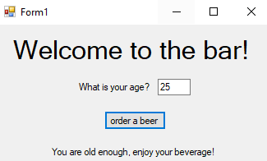
Your turn!
Create an app that asks a user to enter their age and lets them order a beer.
If they are over 18 years old, they can order a beer, otherwise, they cannot.
Show an appropriate message in each case
Make the GUI look somewhat like this ->

Slide 9
Nested if-statements
int nrOfItems = Convert.ToInt32(tbItems.Text);
double price = Convert.ToInt32(tbPrice.Text);
double totalPrice = nrOfItems * price;
if (nrOfItems > 6)
{
if (nrOfItems < 10)
{ //10% discount
totalPrice = totalPrice * 0.9;
}
else
{ //20% discount
totalPrice = totalPrice * 0.8;
}
}

Slide 10

Controls: checkbox and radiobutton
To select and choose between options
Radiobuttons are exclusive, checkboxes are not
Both have a .Checked property that indicates if they are selected by a Boolean value. (e.g. rbnDrink.Checked or cbAge.Checked)

Slide 11
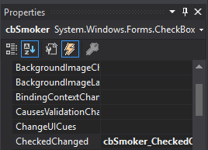

Properties and events
CheckBox
Events of the Control
CheckBoxes in the form
Event for un-/checking the Control
private void cbSmoker_CheckedChanged(object sender, EventArgs e)
{
if(cbSmoker.Checked)
{
<statements>
}
}
Notes:
You still need to check whether the CheckBox is checked.

Slide 12
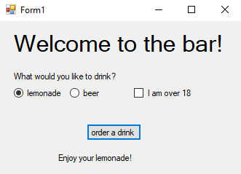
Your turn!
Expand your previous app to contain a choice of drinks (by radiobutton) and a checkbox to indicate if the user is old enough to order beer.
Show a message for each possible situation

Slide 13

Questions?

Slide 14
Intro: Operators
Applications might require to perform different kinds of comparisons
Relational operators
Equality operators
Additionally, you might want to check for multiple conditions within one conditional statement
Logical operators

Slide 15
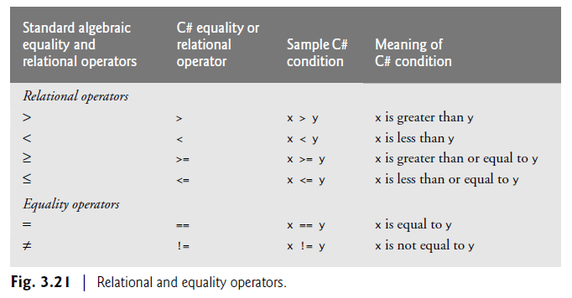
Syntax

Slide 16
Syntax (cont.)
bool p = true; bool q = false;
Logical Operator | C# Operator | C# expression | Meaning
Logical Negation | ! | !p | Reverse the meaning of p
Conditional And | && | p && q | True if both of its operands are true (stops if p is false)
Conditional Or | || | p || q | True if either of its operands is true (stops if p is true)

Slide 17
Examples
if (roomType == "Single" || roomType == “Twin")
{
<statements>
if (roomType == “Twin" && nrOfDays > 5)
{
<statements>
}
else
{
<statements>
}
}

Slide 18
Your turn!
If you used nested if statements in your drink ordering app, replace them using logical operators.

Slide 19
Questions?

Slide 20
2

Slide 21
Intro: Styling
How to improve readability of code?
Pragmatics
How to make sure you know what you/other developer meant?
Comments
Naming conventions
Space & indentation
Curly brackets
KISS
Notes:
KISS = Keep It Simple, Stupid

Slide 22
Examples
int monthsInYear = 12;
double bonusPercentage = 0.08;
double bonus = 0;
double monthlyIncome = Convert.ToDouble(tbMonthlyIncome.Text);
double holidayIncome = Convert.ToDouble(tbHolidayIncome.Text);
string getsBonus = tbBonus.Text;
double yearlyIncome = monthsInYear * monthlyIncome;
if(getsBonus == ”yes”)
{
bonus = yearlyIncome * bonusPercentage;
}
yearlyIncome = yearlyIncome + holidayIncome + bonus;
Bad vs Good
double a = Convert.ToDouble(textBox1.Text);
double b = Convert.ToDouble(textBox2.Text);
string c = textBox3.Text;
double d = 12 * a; double e = 0;
if(c == ”yes”)
e = d * 0.08;
d = d + e + b;
Notes:
They represent the same behavior

Slide 23
Extra information
Include single-line comments by using //
Include multiline comments by using /* … */
Follow naming conventions:
For now, lowercase names for variables
Also, camelCase for variable names
// this is a comment
/*
* This is a multiline comment
* Can be used for explaining the purpose of different elements
*/

Slide 24
Questions?

Slide 25
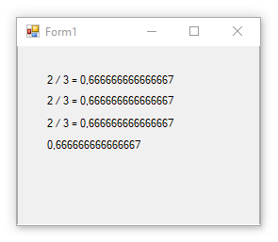
Formatting strings: several ways
double a = 2;
double b = 3;
label1.Text = a + " / " + b + " = " + a/b;
label2.Text = $"{a} / {b} = {a/b}";
label3.Text = string.Format("{0} / {1} = {2}", a, b, a/b);
label4.Text = (a/b).ToString();
Implicit conversion
Explicit conversion

Slide 26
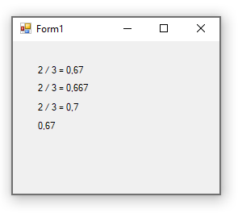
Formatting strings: fixing decimals
double a = 2;
double b = 3;
label1.Text = a + " / " + b + " = " + $"{a/b:f2}";
label2.Text = $"{a} / {b} = {a/b:f3}";
label3.Text = string.Format("{0} / {1} = {2:0.0}", a, b, a/b);
label4.Text = (a/b).ToString("0.00");

Slide 27
Questions?

Slide 28
Controls: Picturebox
What if we wanted to add some pictures?

Slide 29
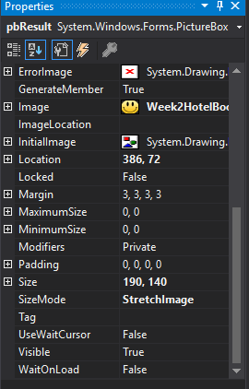

Picturebox
PictureBox
The selected picture
PictureBox in the form
Select how the picture is shown

Slide 30
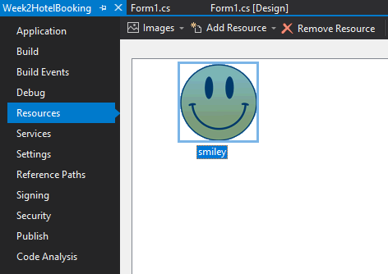
Picturebox: adding resources
Pictures can be added as resources to a project
Right-click on Project Name -> Properties -> Resources
Add existing resources here

Slide 31
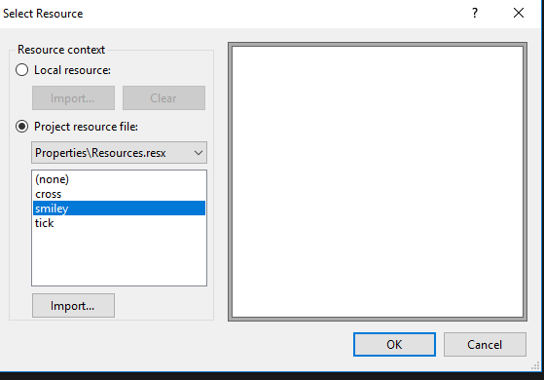
Extra information (cont.)
Select the image displayed in the PictureBox
Select PictureBox -> Properties -> Image
Select PictureBox -> Properties -> SizeMode to change the scaling of the picture
See existing resources

Slide 32
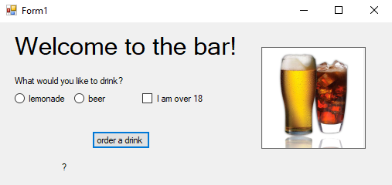
Your turn!
Add some pictures to your app.

Slide 33
Variable scope
The scope of a variable, sometimes referred to as accessibility of a variable, refers to where the variable can be read from and/or written to, and the variable's lifetime, or how long it stays in memory.
-MSDN
In general, a local variable is only available after declaration in the block of code in which it has been declared.

Slide 34
Variable scope: example
{
double a = Convert.ToDouble(tbInput.Text);
if (a != 0)
{
double b = 1 / a;
MessageBox.Show("1 divided by {0} is {1} ", a, b);
}
}

Slide 35
Variable scope: example
{
double a = Convert.ToDouble(tbInput.Text);
if (a != 0)
{
double b = 1 / a;
Messagebox.Show("1 divided by {0} is {1} ", a, b);
}
}

Slide 36
Variable scope: example
{
double a = Convert.ToDouble(tbInput.Text);
if (a != 0)
{
double b = 1 / a;
Messagebox.Show("1 divided by {0} is {1} ", a, b);
}
}

Slide 37
Questions?

Slide 38

Summary
If-statements to implement decision-making
Relational, equality and logical operators to build conditions
Best practices to improve code readability
WinForms components to design more complex user interfaces

Slide 39

What to do next?
Assignments week 2

